Slide 1


Experiment 7
Delta-Wye Transformer – 4 wire - Ungrounded System
Ground Fault
Dr. Norbert Doerry and Dr. John V. Amy Jr.
http://doerry.org/norbert/MarineElectricalPowerSystems/index.htm
© 2024 by Norbert Doerry and John Amy
This work is licensed via: CC BY 4.0 (https://creativecommons.org/)

Slide 2

Schematic
$$V_{secondary_ll}=\frac{\sqrt{3}}{n}V_{primary}=\frac{\sqrt{3}}{5.2}208=69.3 volts rms (98 V peak)$$
$I_{secondary}=\frac{n}{\sqrt{3}}I_{primary }$
(Neglecting losses)
C_{p} = 2.2 µF
R = 1200 Ω
R_{L} = 300 Ω
R_{La} = 300 Ω
R_{lamp} = 450 Ω
N = 5.2
R_{lamp}
Common Mode Current Probe
Current Meter (all phases)
Voltage Meter (all phases)

Slide 3
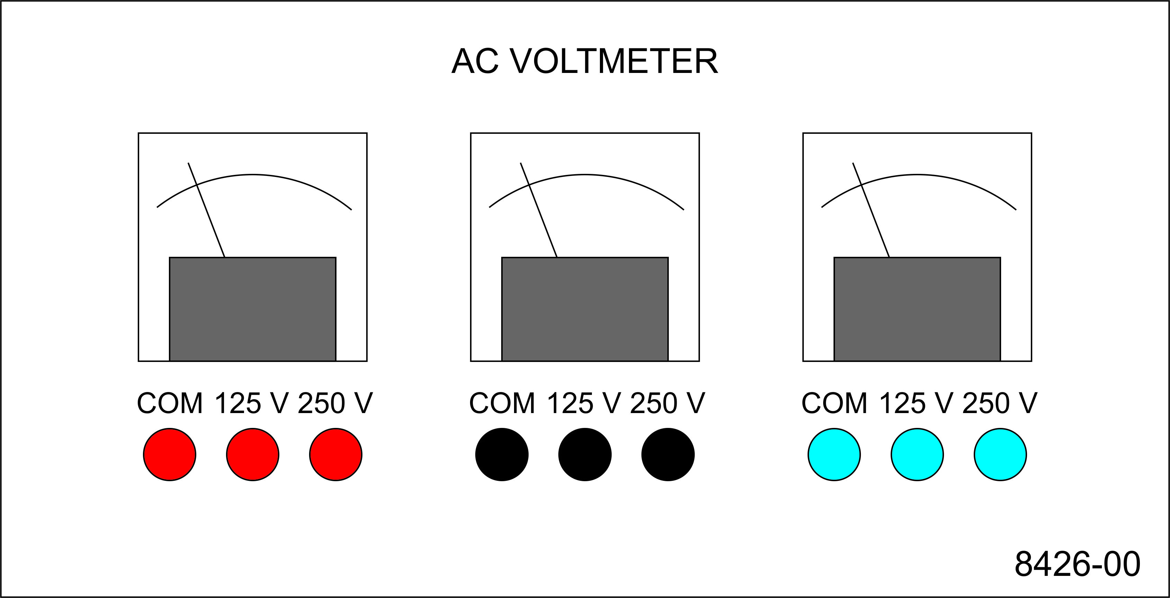
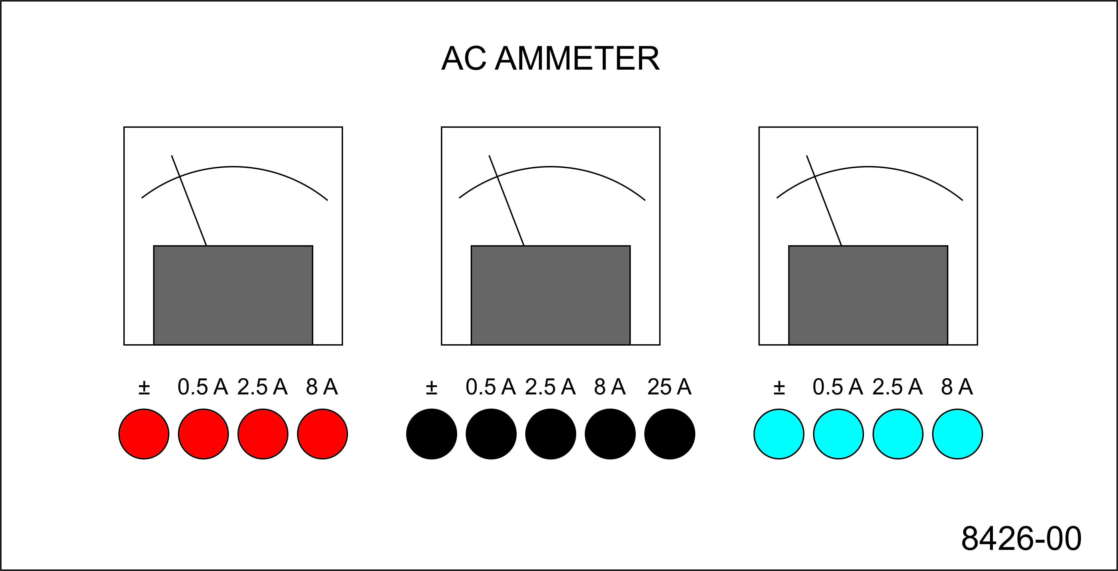
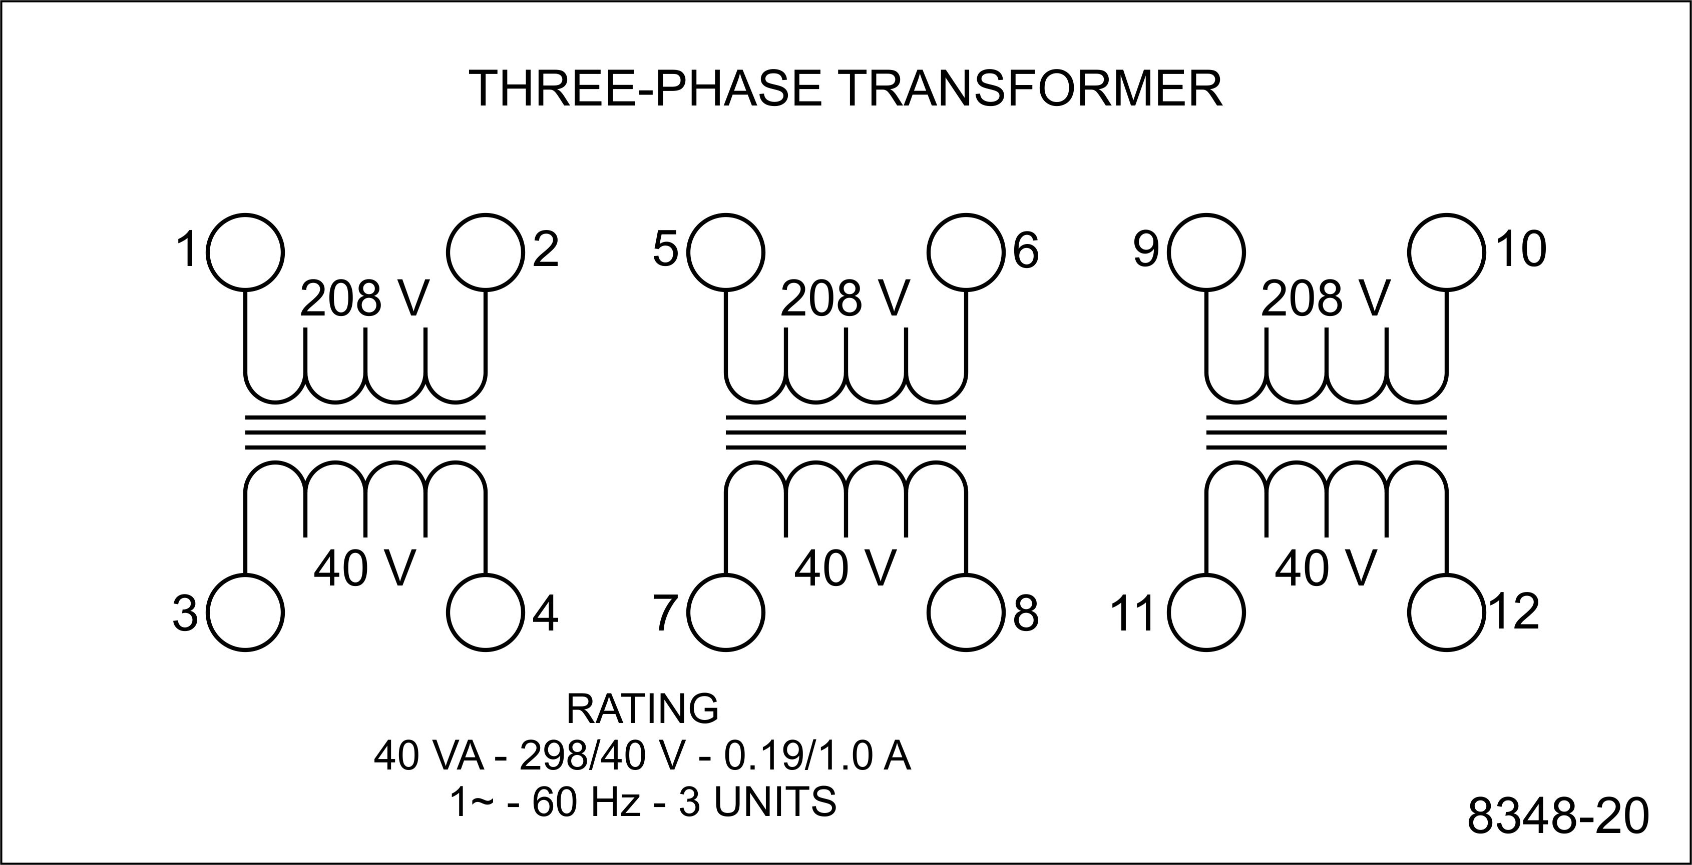
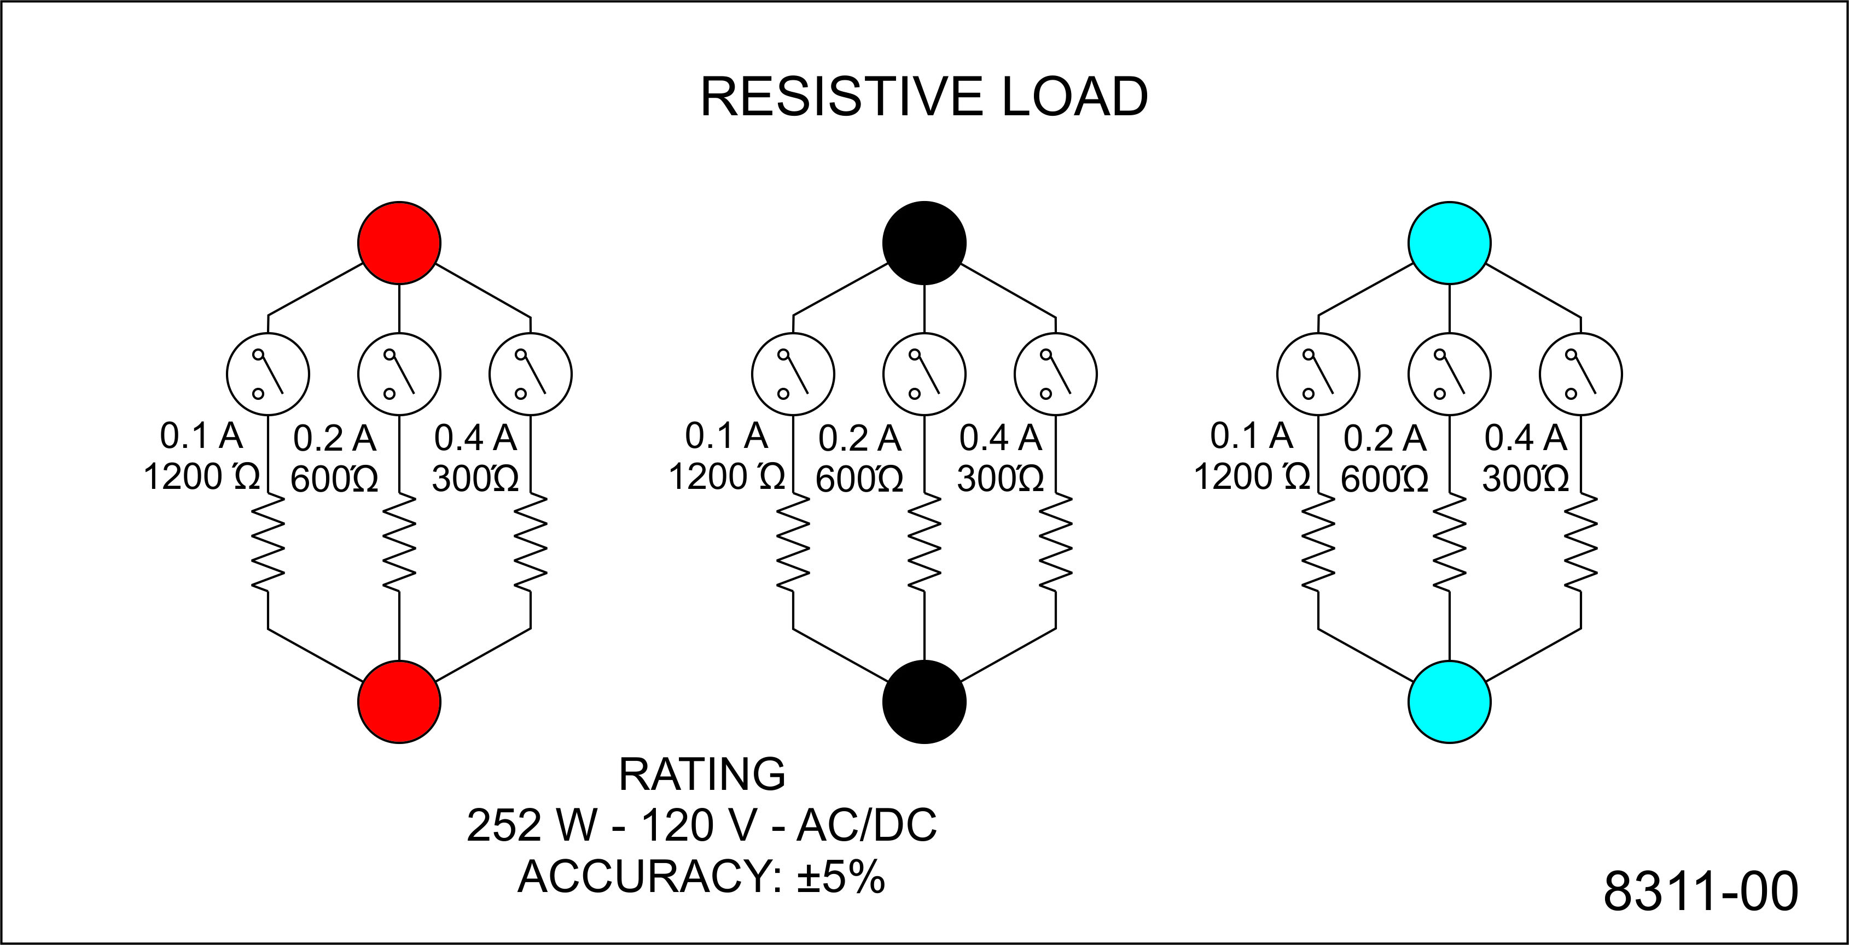
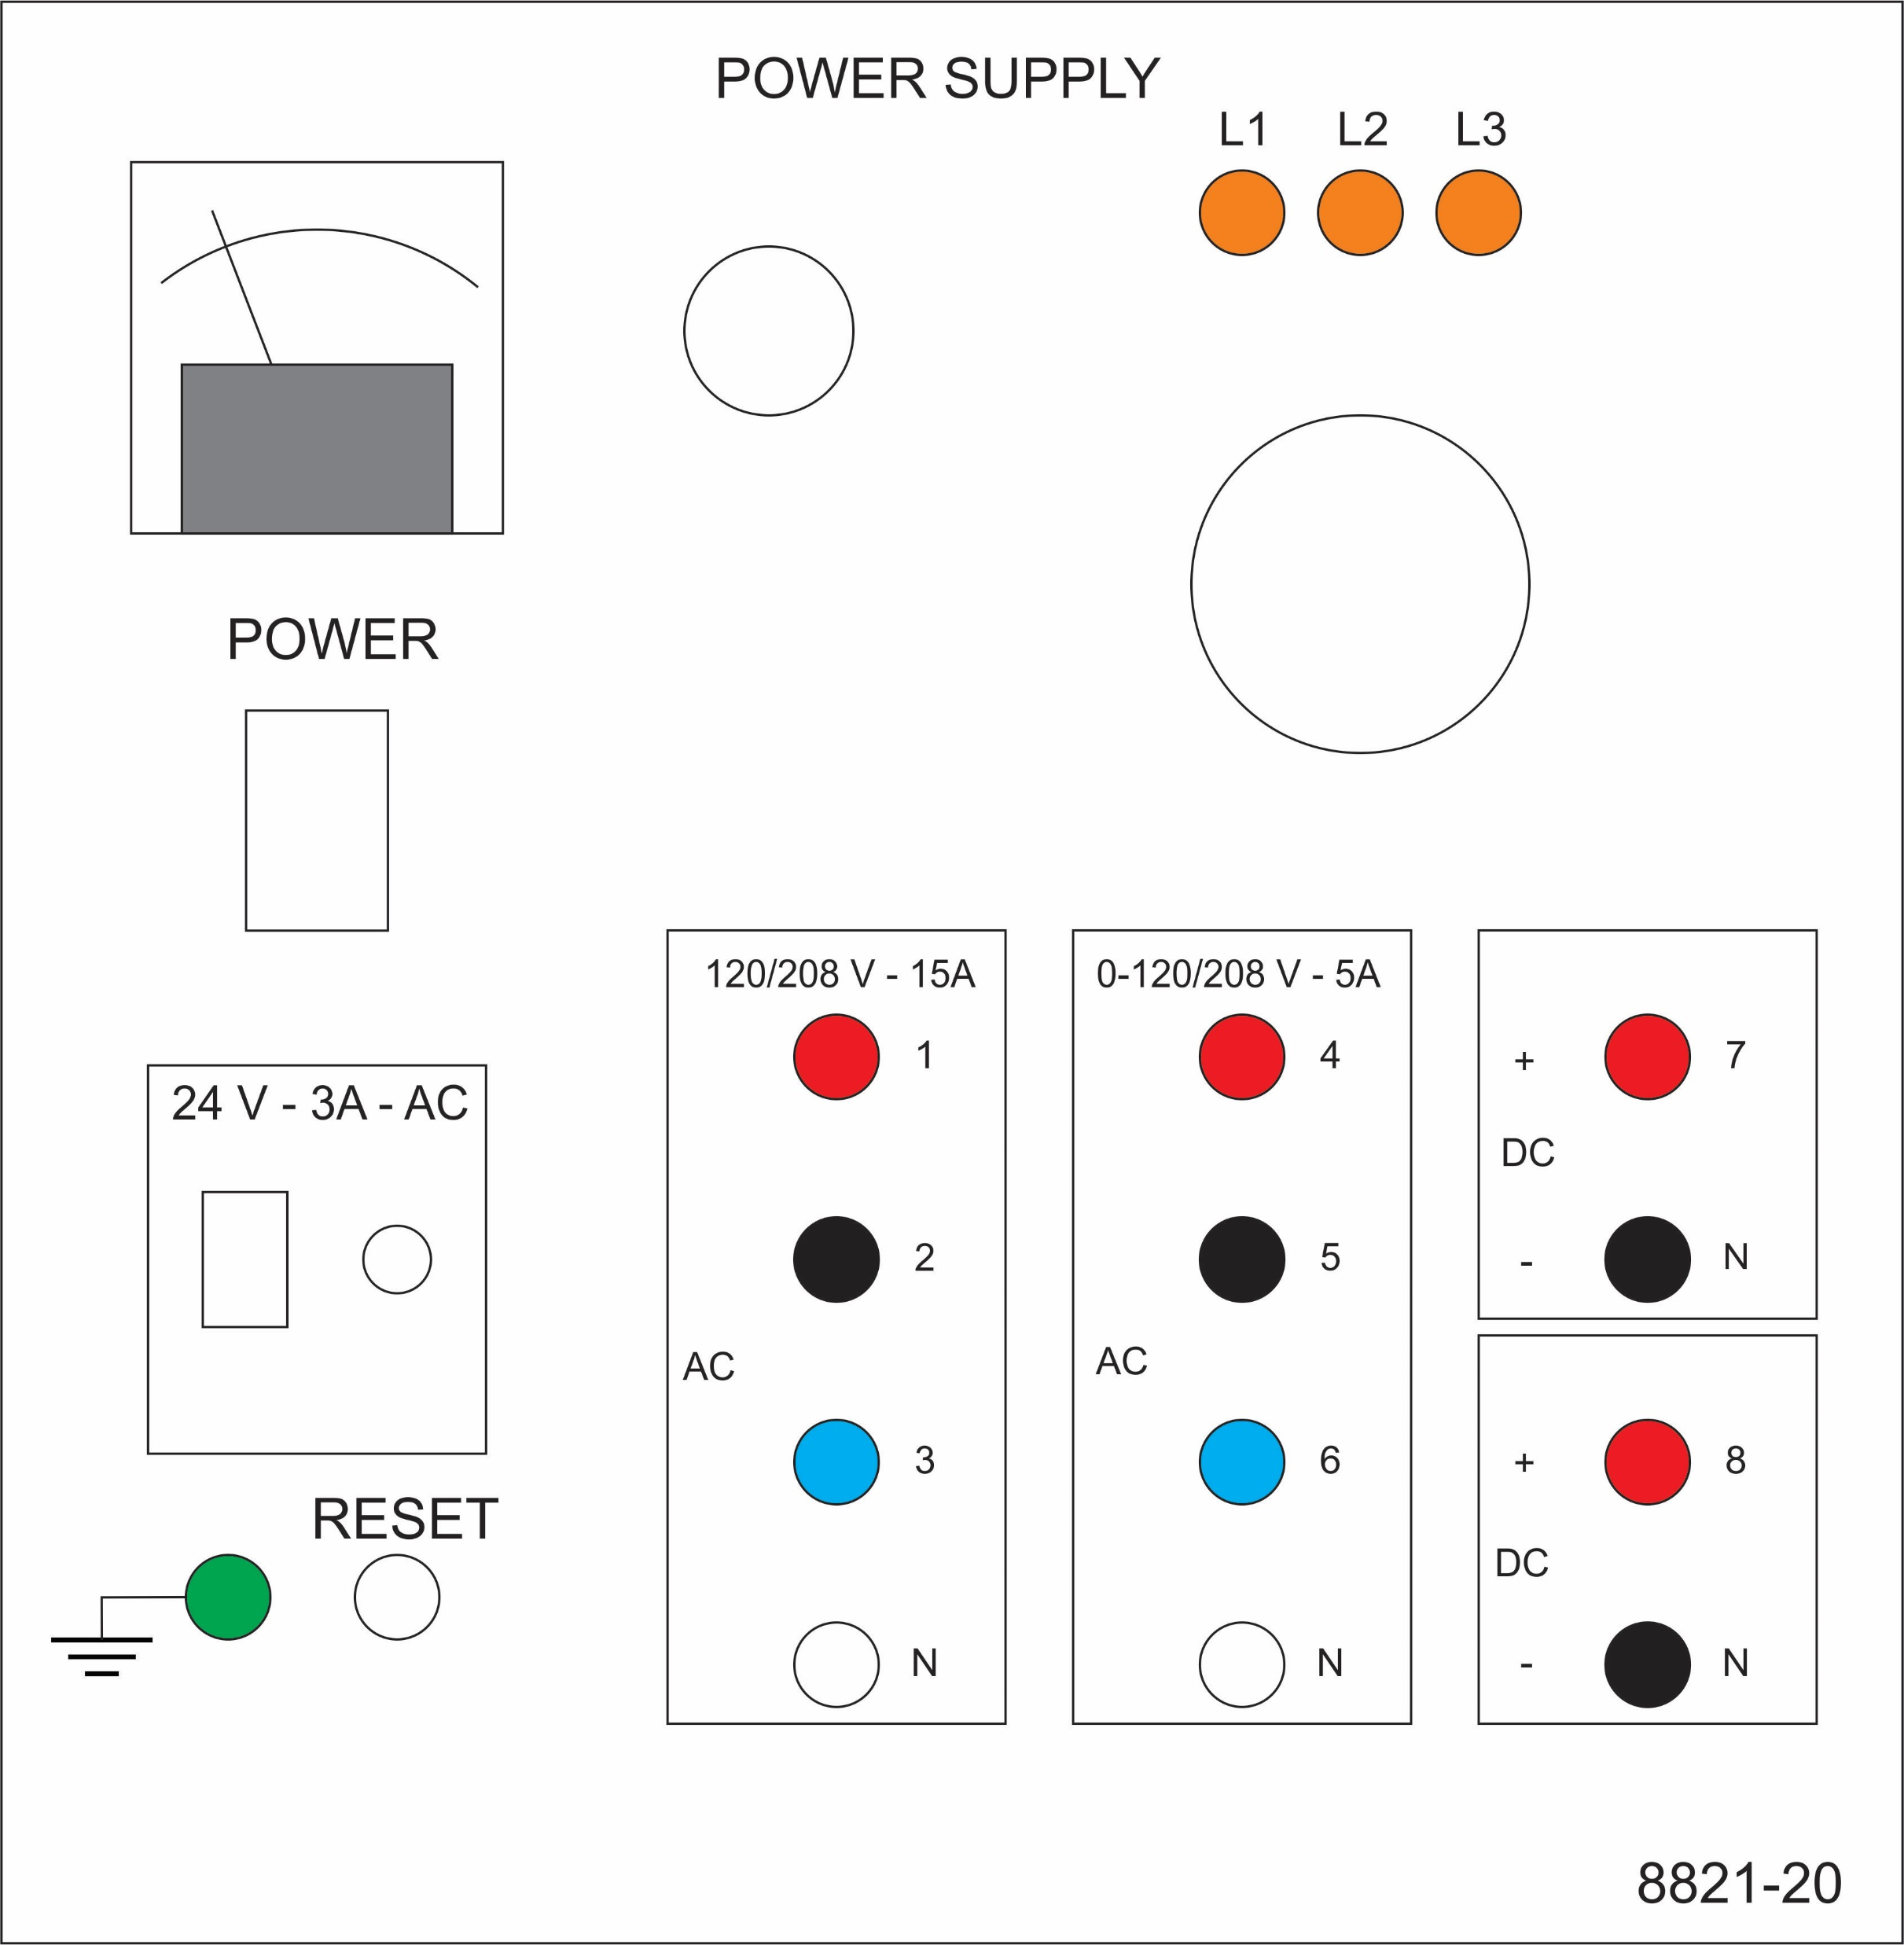
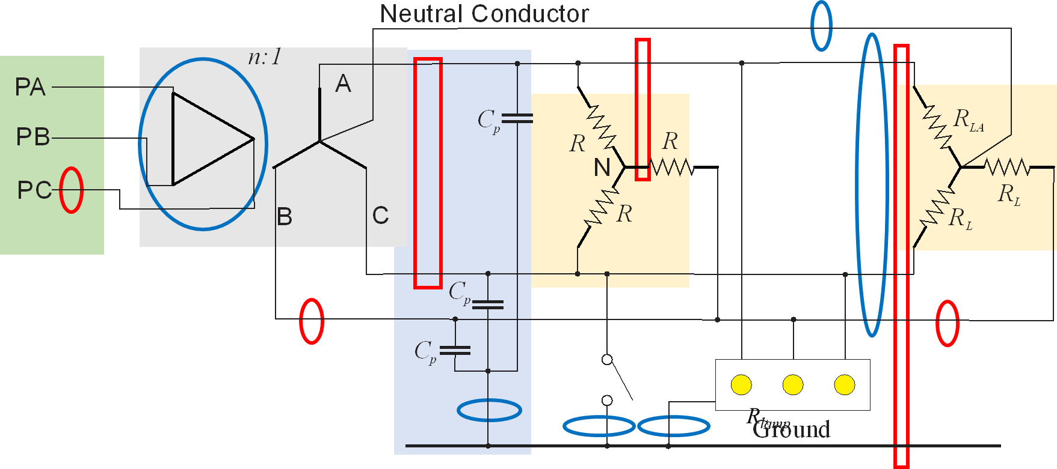
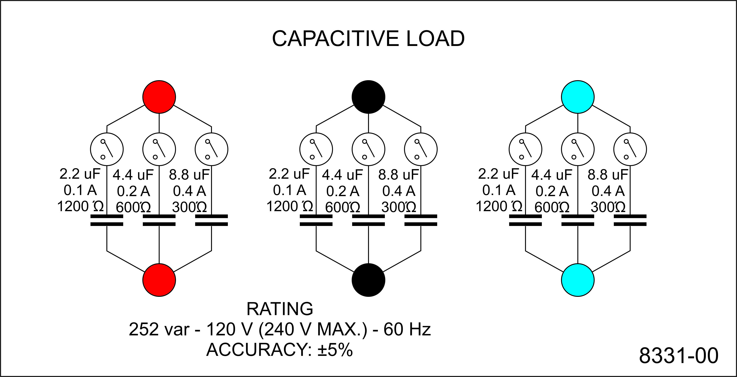
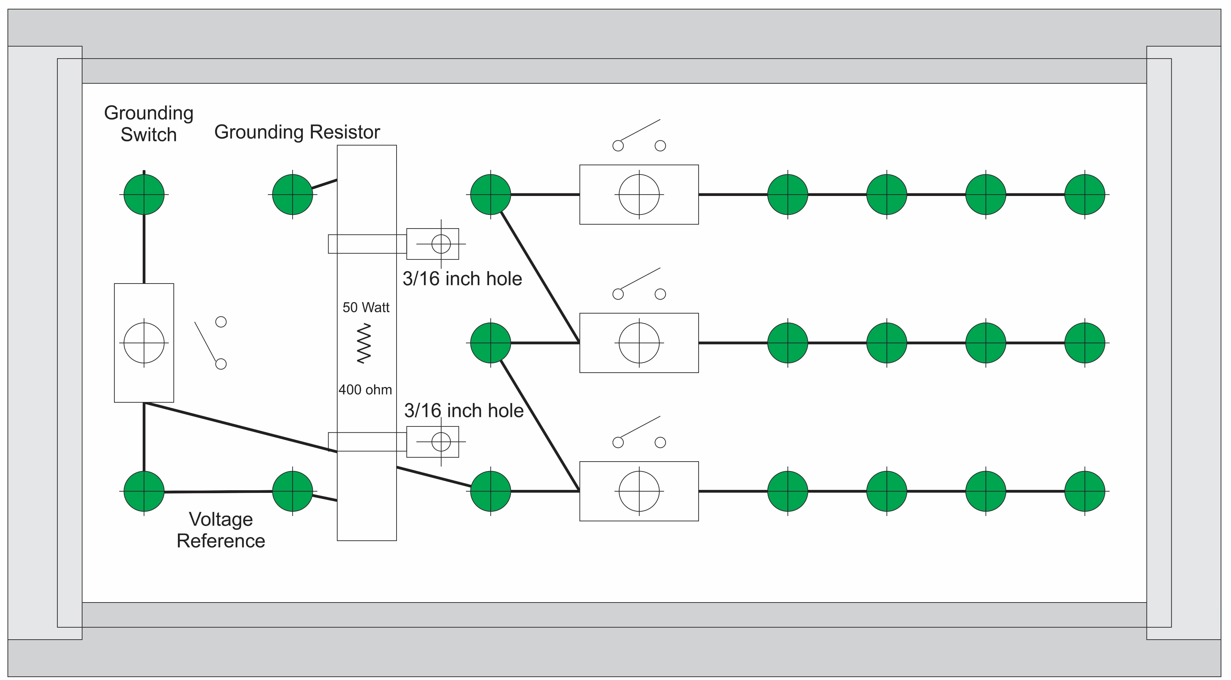
Experiment 7
Secondary - LL
Secondary - LN
Secondary - LG
Primary line
Secondary line
Load line
Wye
Wye-Load
Parasitic

Slide 4
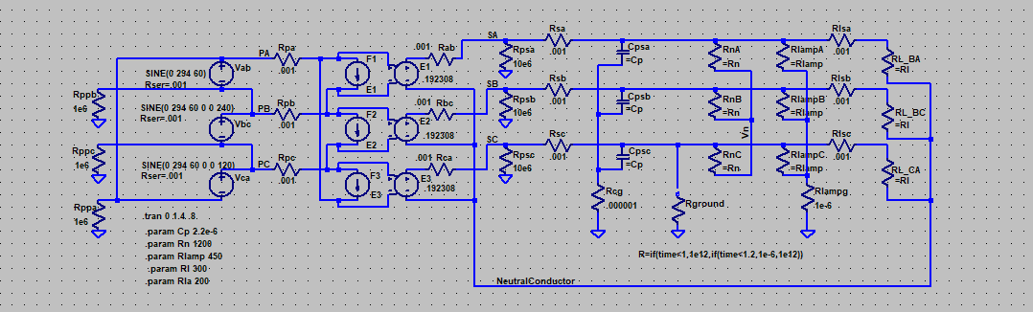
Simulation Model
LTspice
20240908 experiment 7.asc

Slide 5
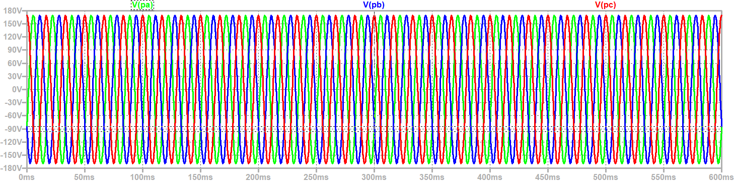
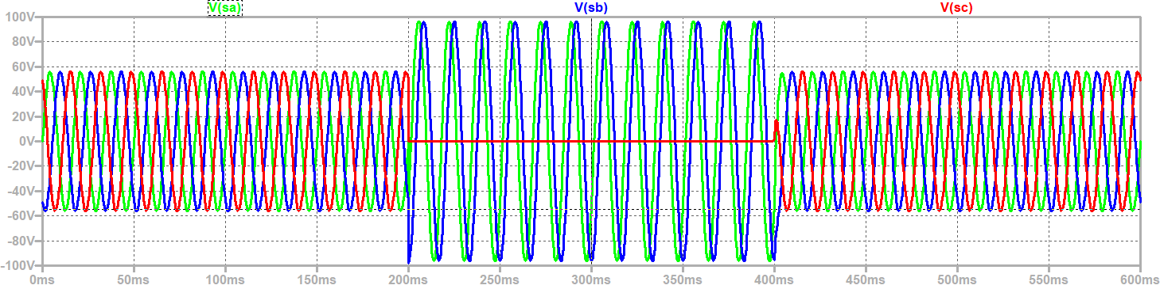
Line to Ground Voltages
Line to ground insulation on secondary should be rated for line-to-line voltage
Primary
Secondary
Ground Fault

Slide 6
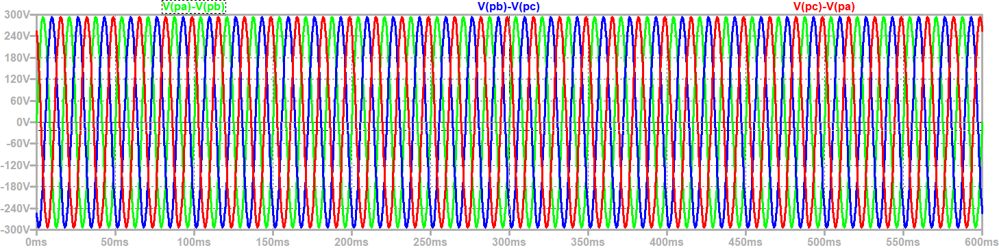
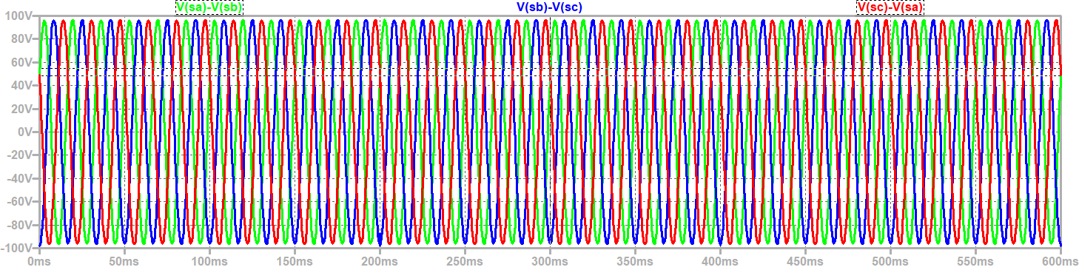
Line to Line Voltages
Primary Line to Line Voltages and Secondary Line to Line voltages not impacted by ground fault
Primary Line to Line Voltage: Peak = 294 volts
Secondary Line to Line Voltage: Peak = 98 V volts
Ground Fault

Slide 7
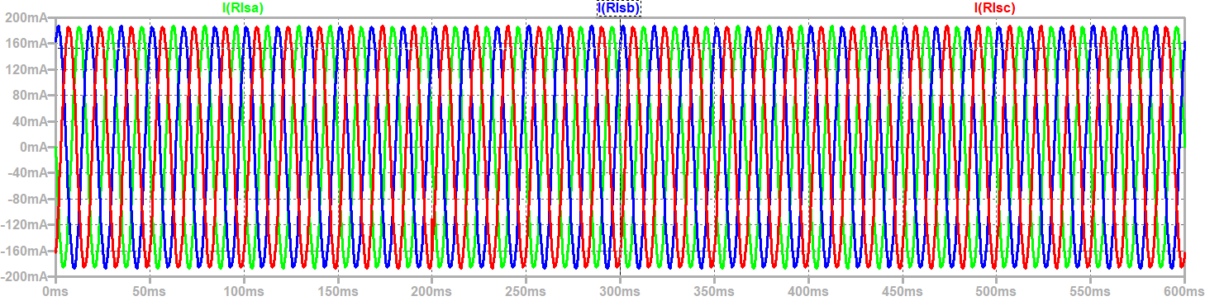
Load Currents
Ground Fault

Slide 8
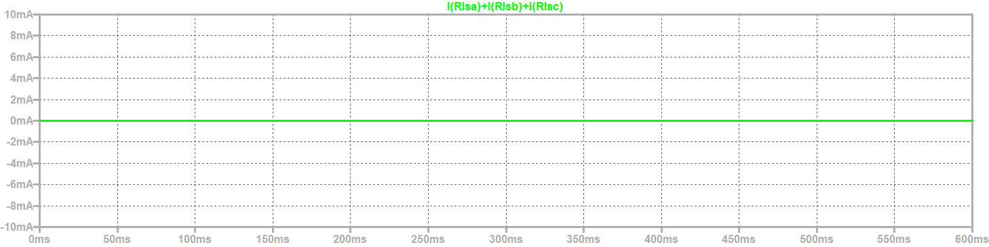
Balanced load with ground fault does not result in Neutral Conductor current
Ground Fault

Slide 9
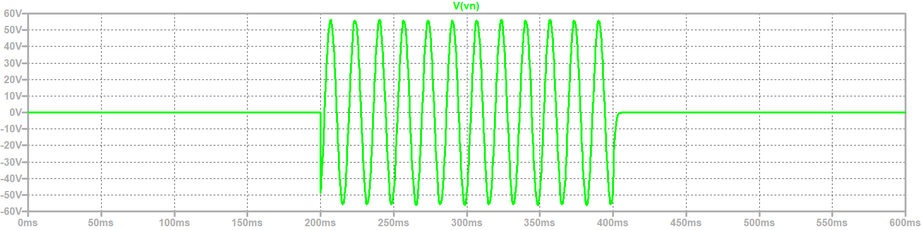
Neutral to Ground Voltage
Ground Fault

Slide 10
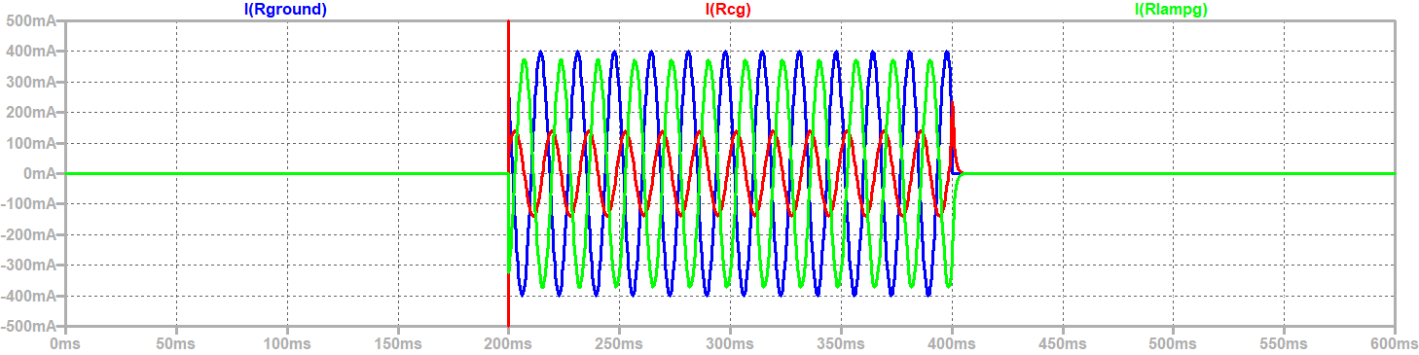
Ground Fault Currents
Ground Fault

Slide 11
Wrap Up

